Slide 1
Synthetic Data for an Imaginary Country, Sample, 2023
090180348 - Gülnur Üstüntepe
090190311 - Kaan Can
090200360 - Sinem Faide Altun

Slide 2





Slide 3
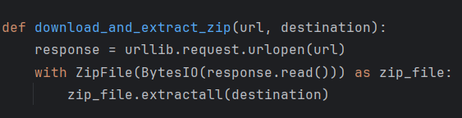
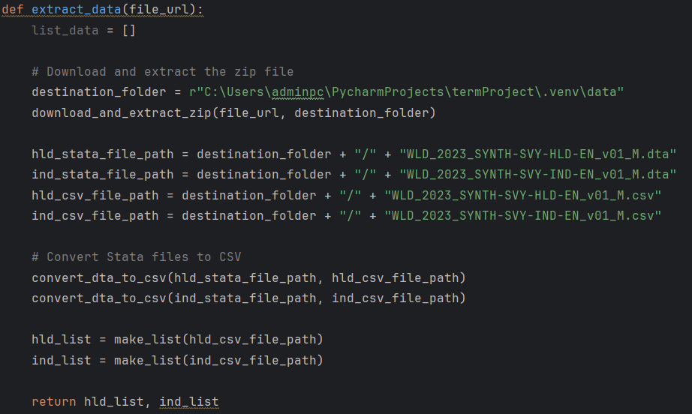
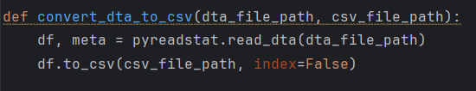
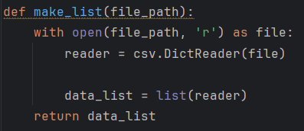

Slide 4
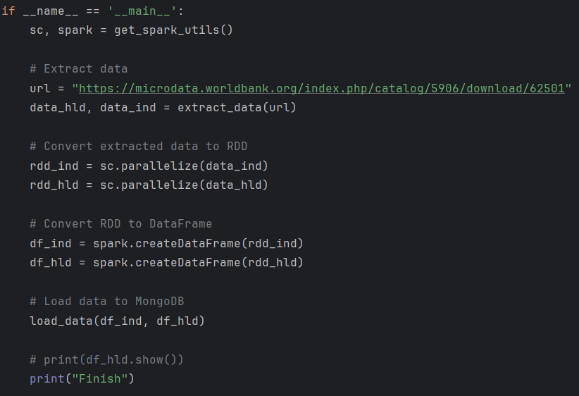
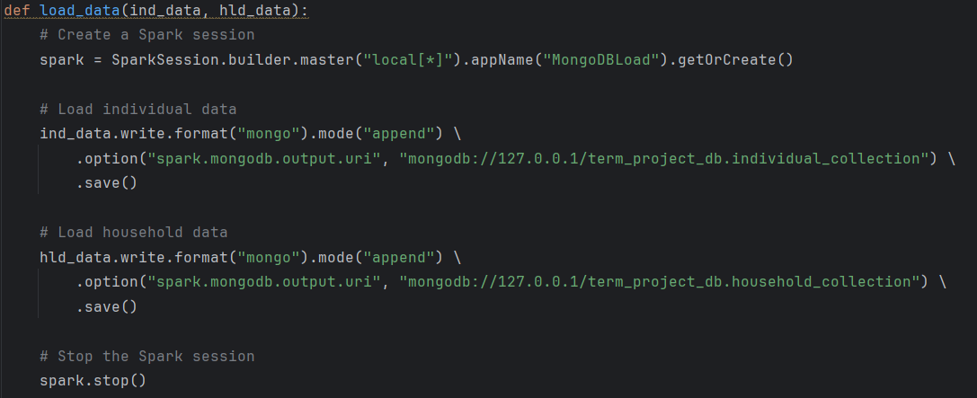

Slide 5
ETL
1 -
2 – FEATURE
EXTRACTION
3 – FEATURE
SELECTION
1 - EDA
4 - MODELING
DF
Selectkbest
Lasso
Ridge
Randomforest
df_household
DF
DF
generated_
houshold_df
df_individual
DF
result_df

Slide 6
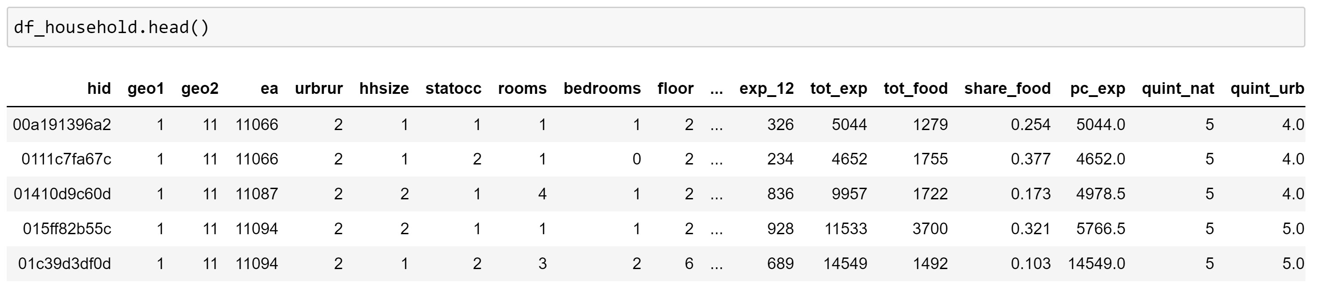

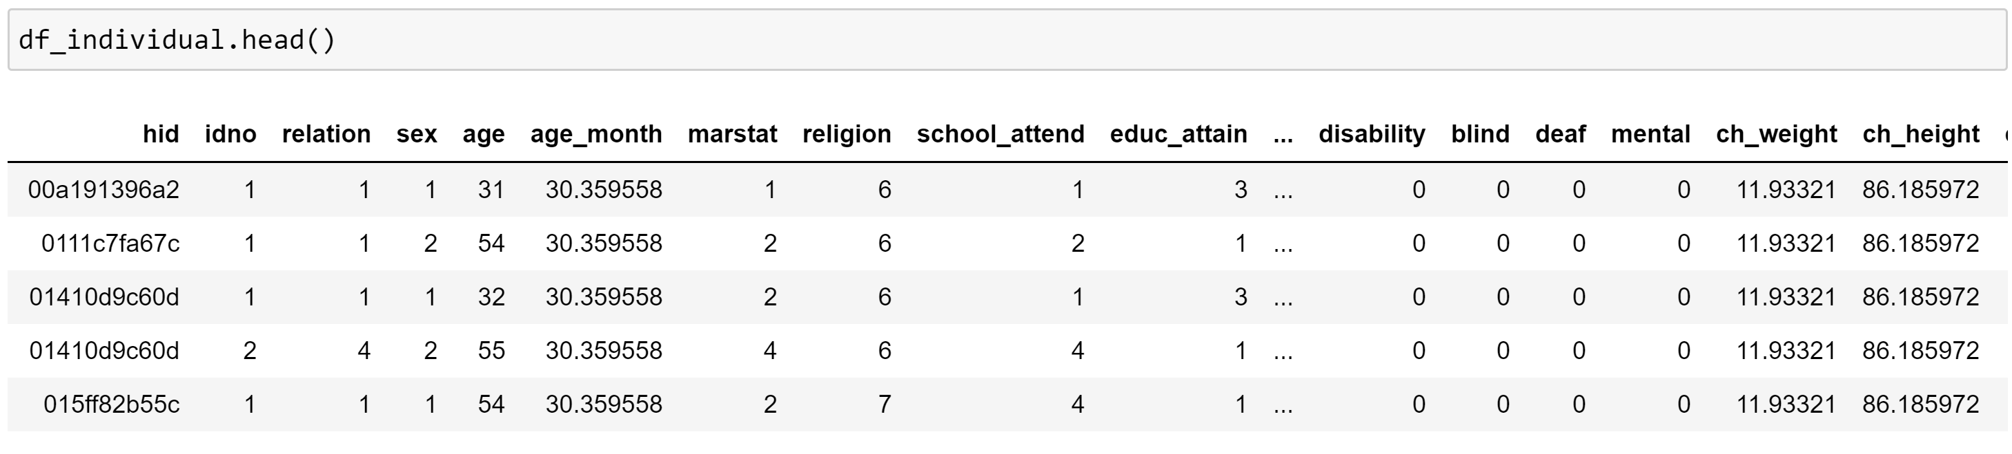

8000x49
32396x27

Slide 7
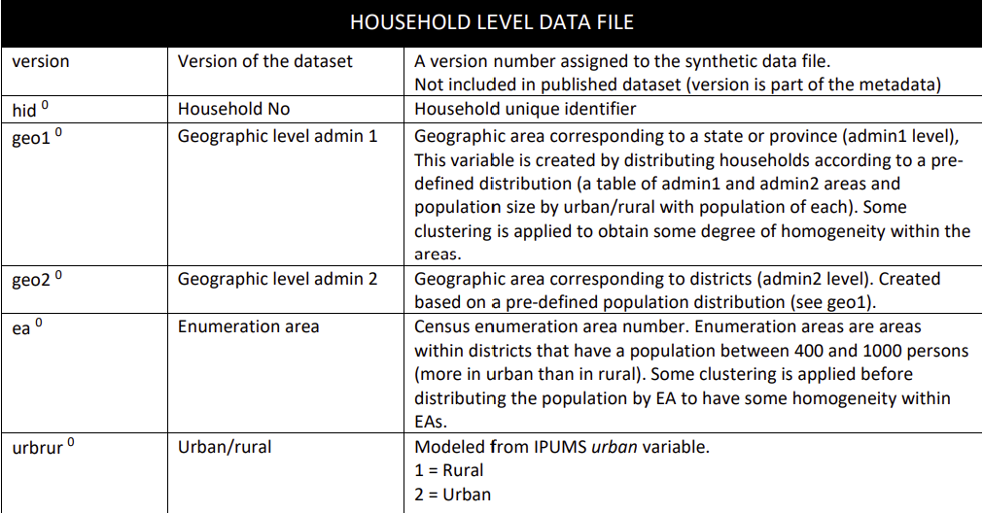
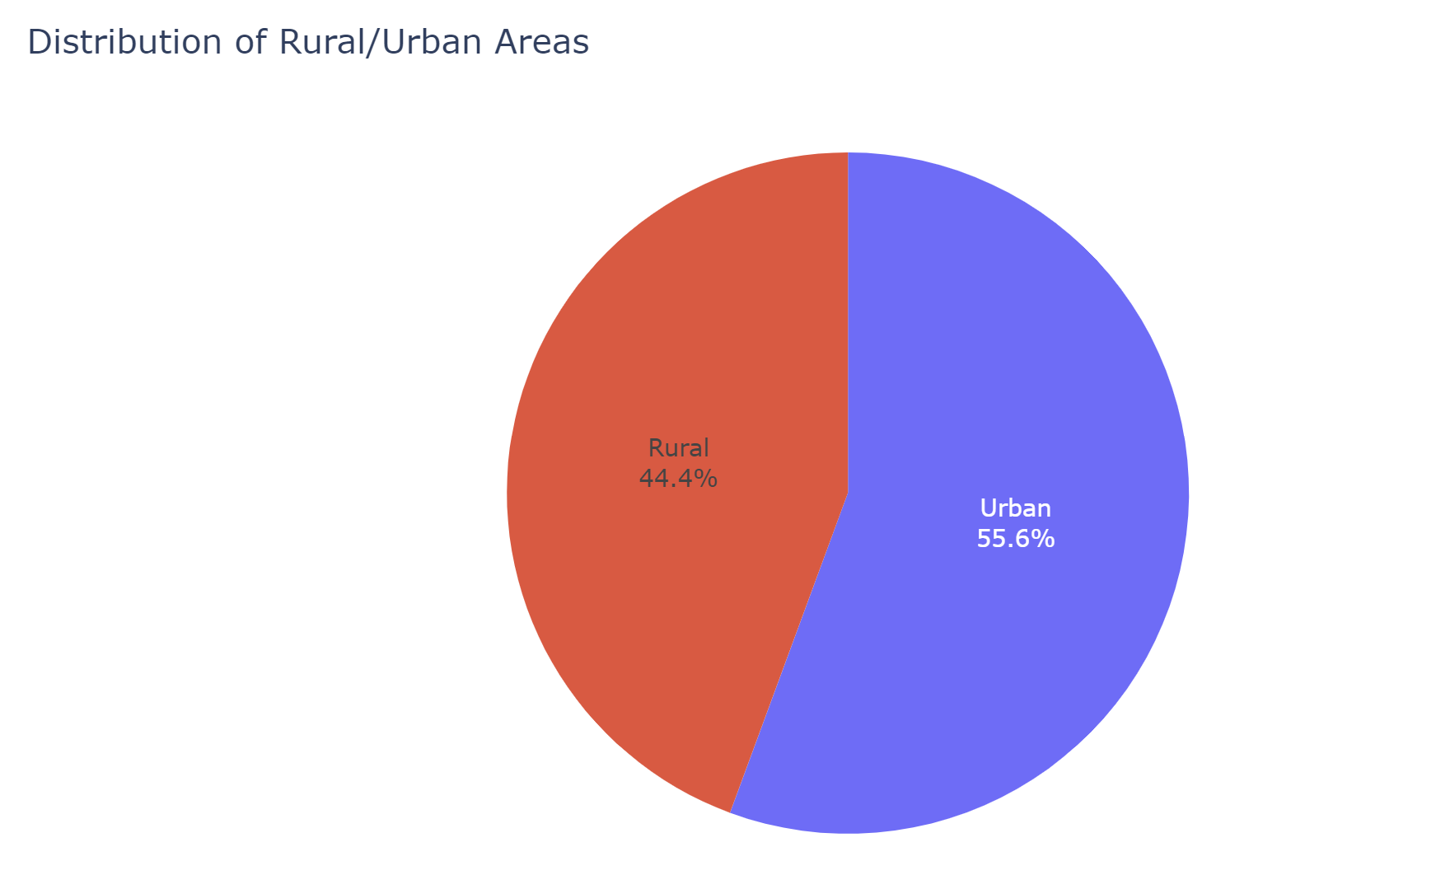
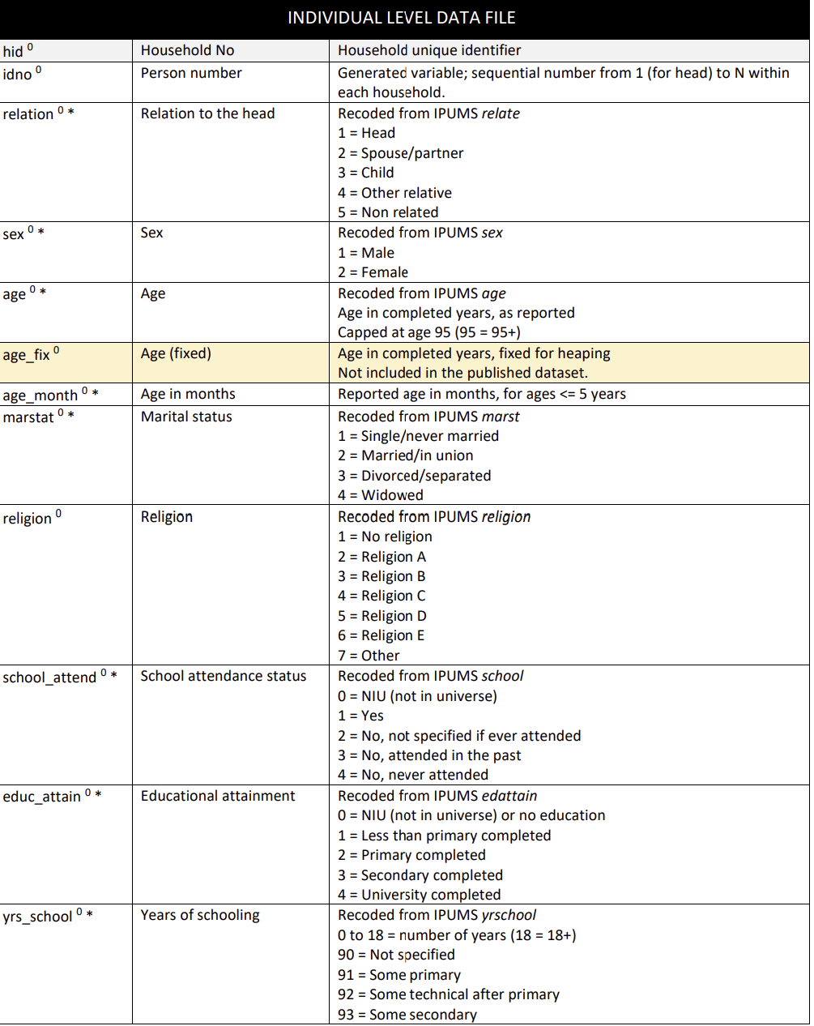

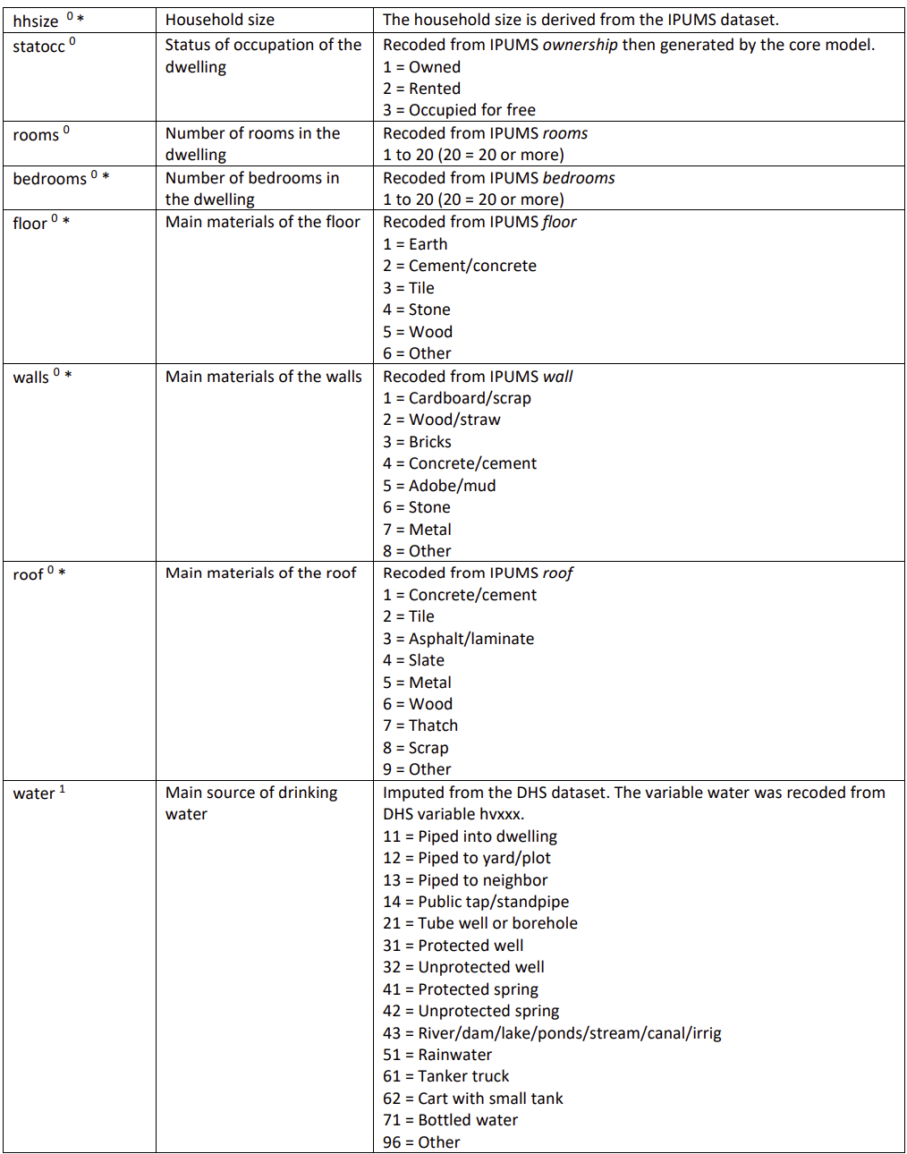

Slide 8
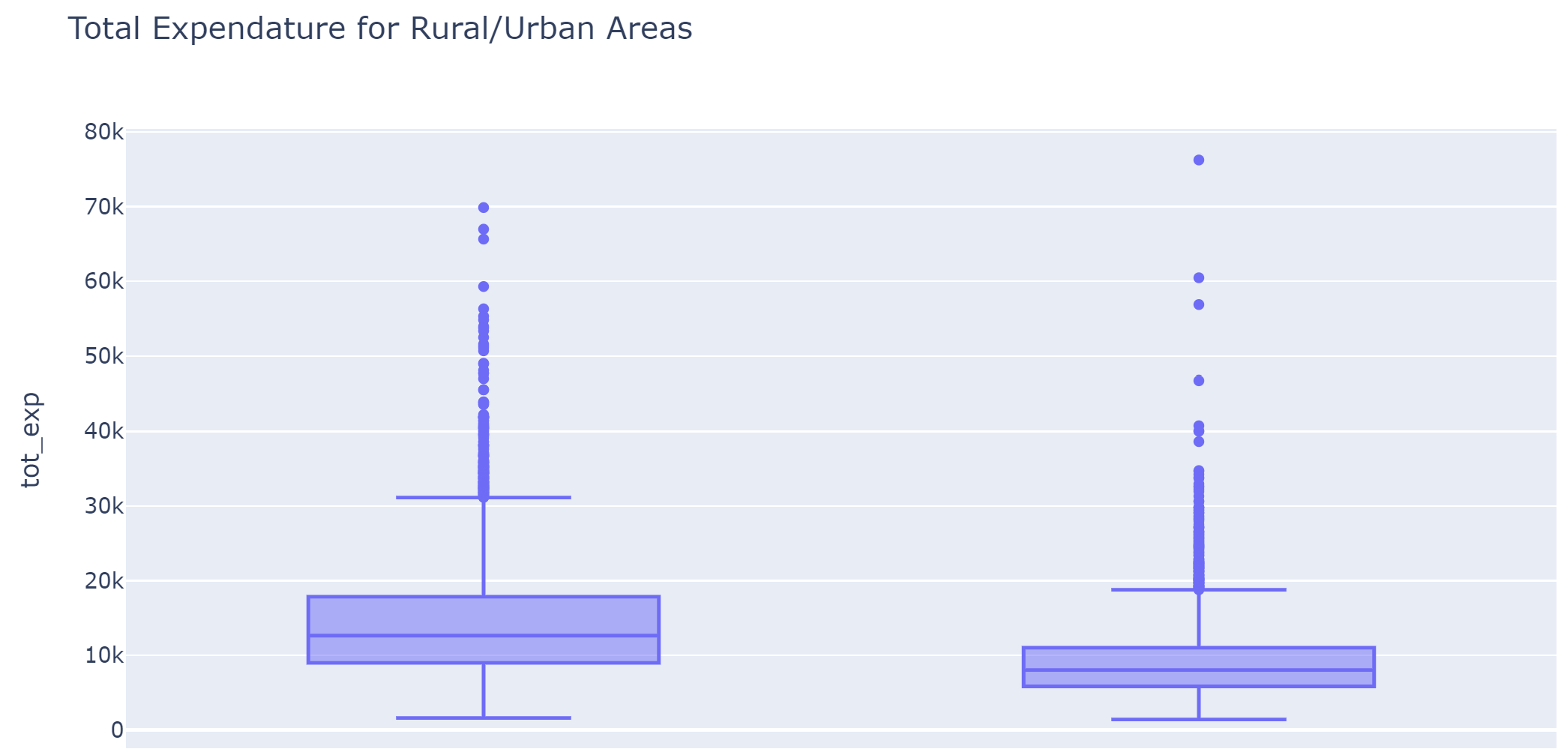
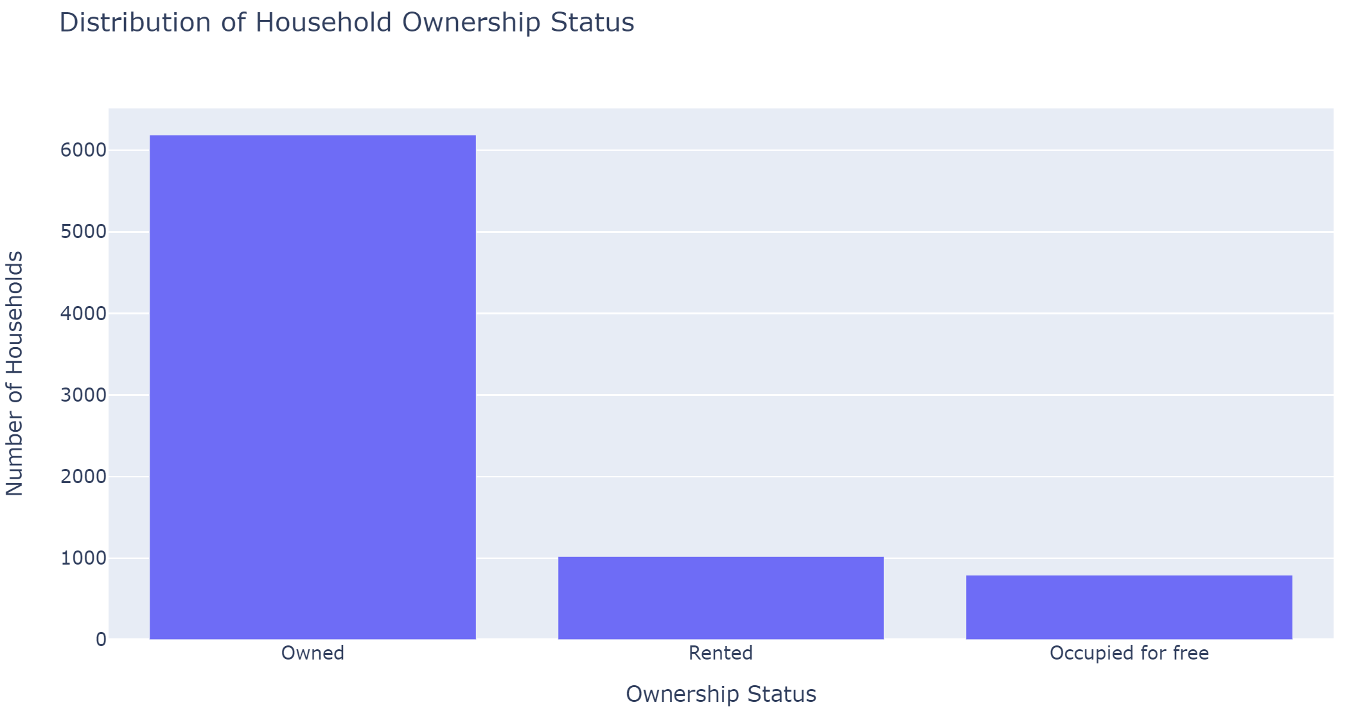
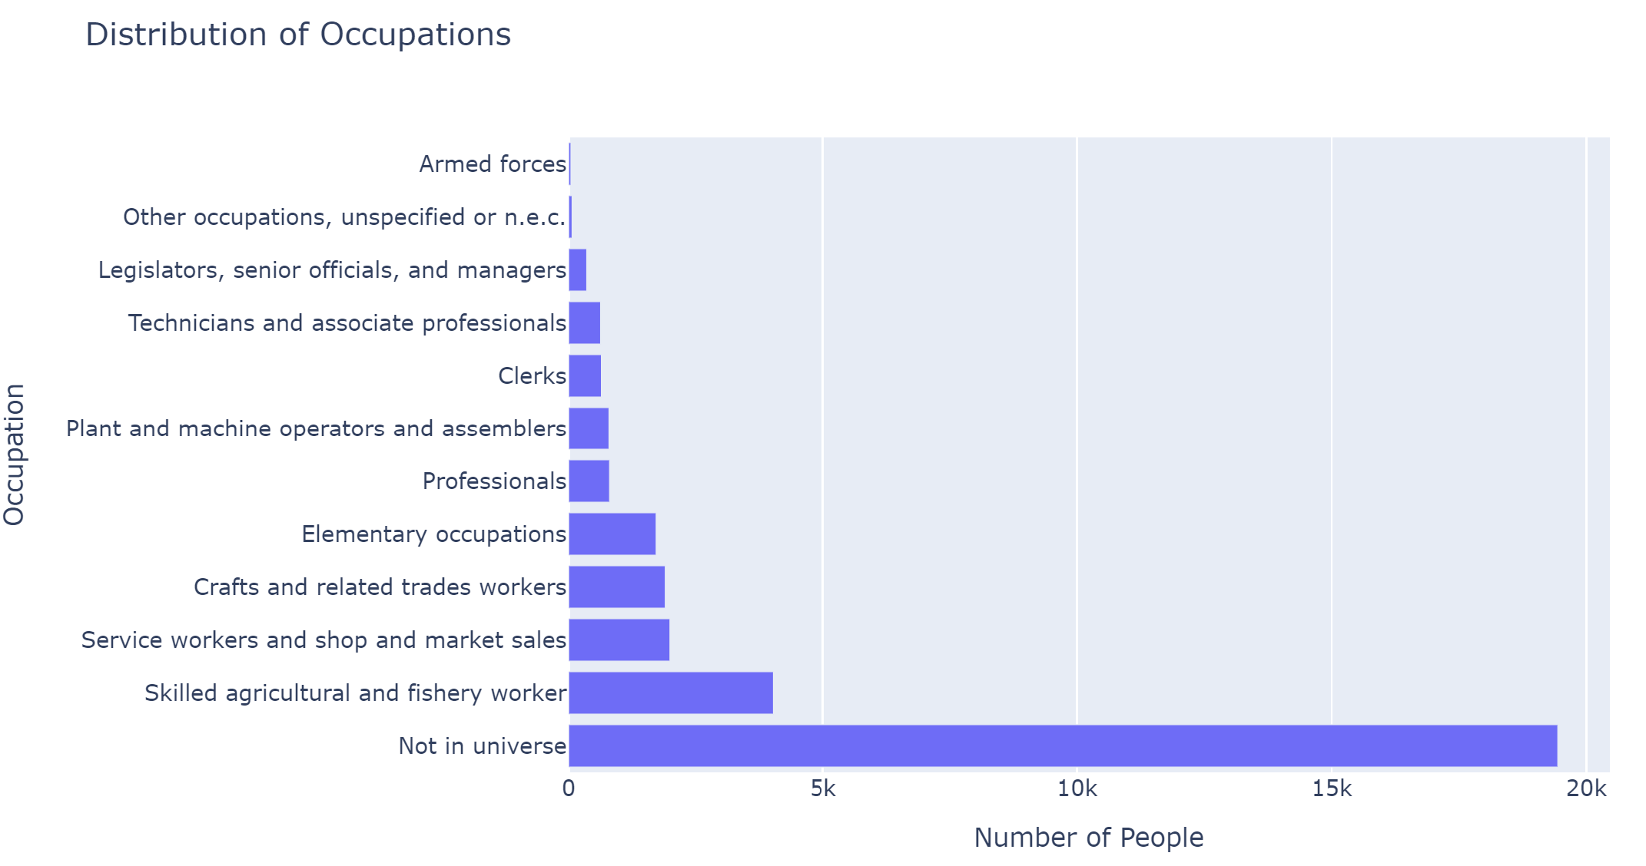

Slide 9
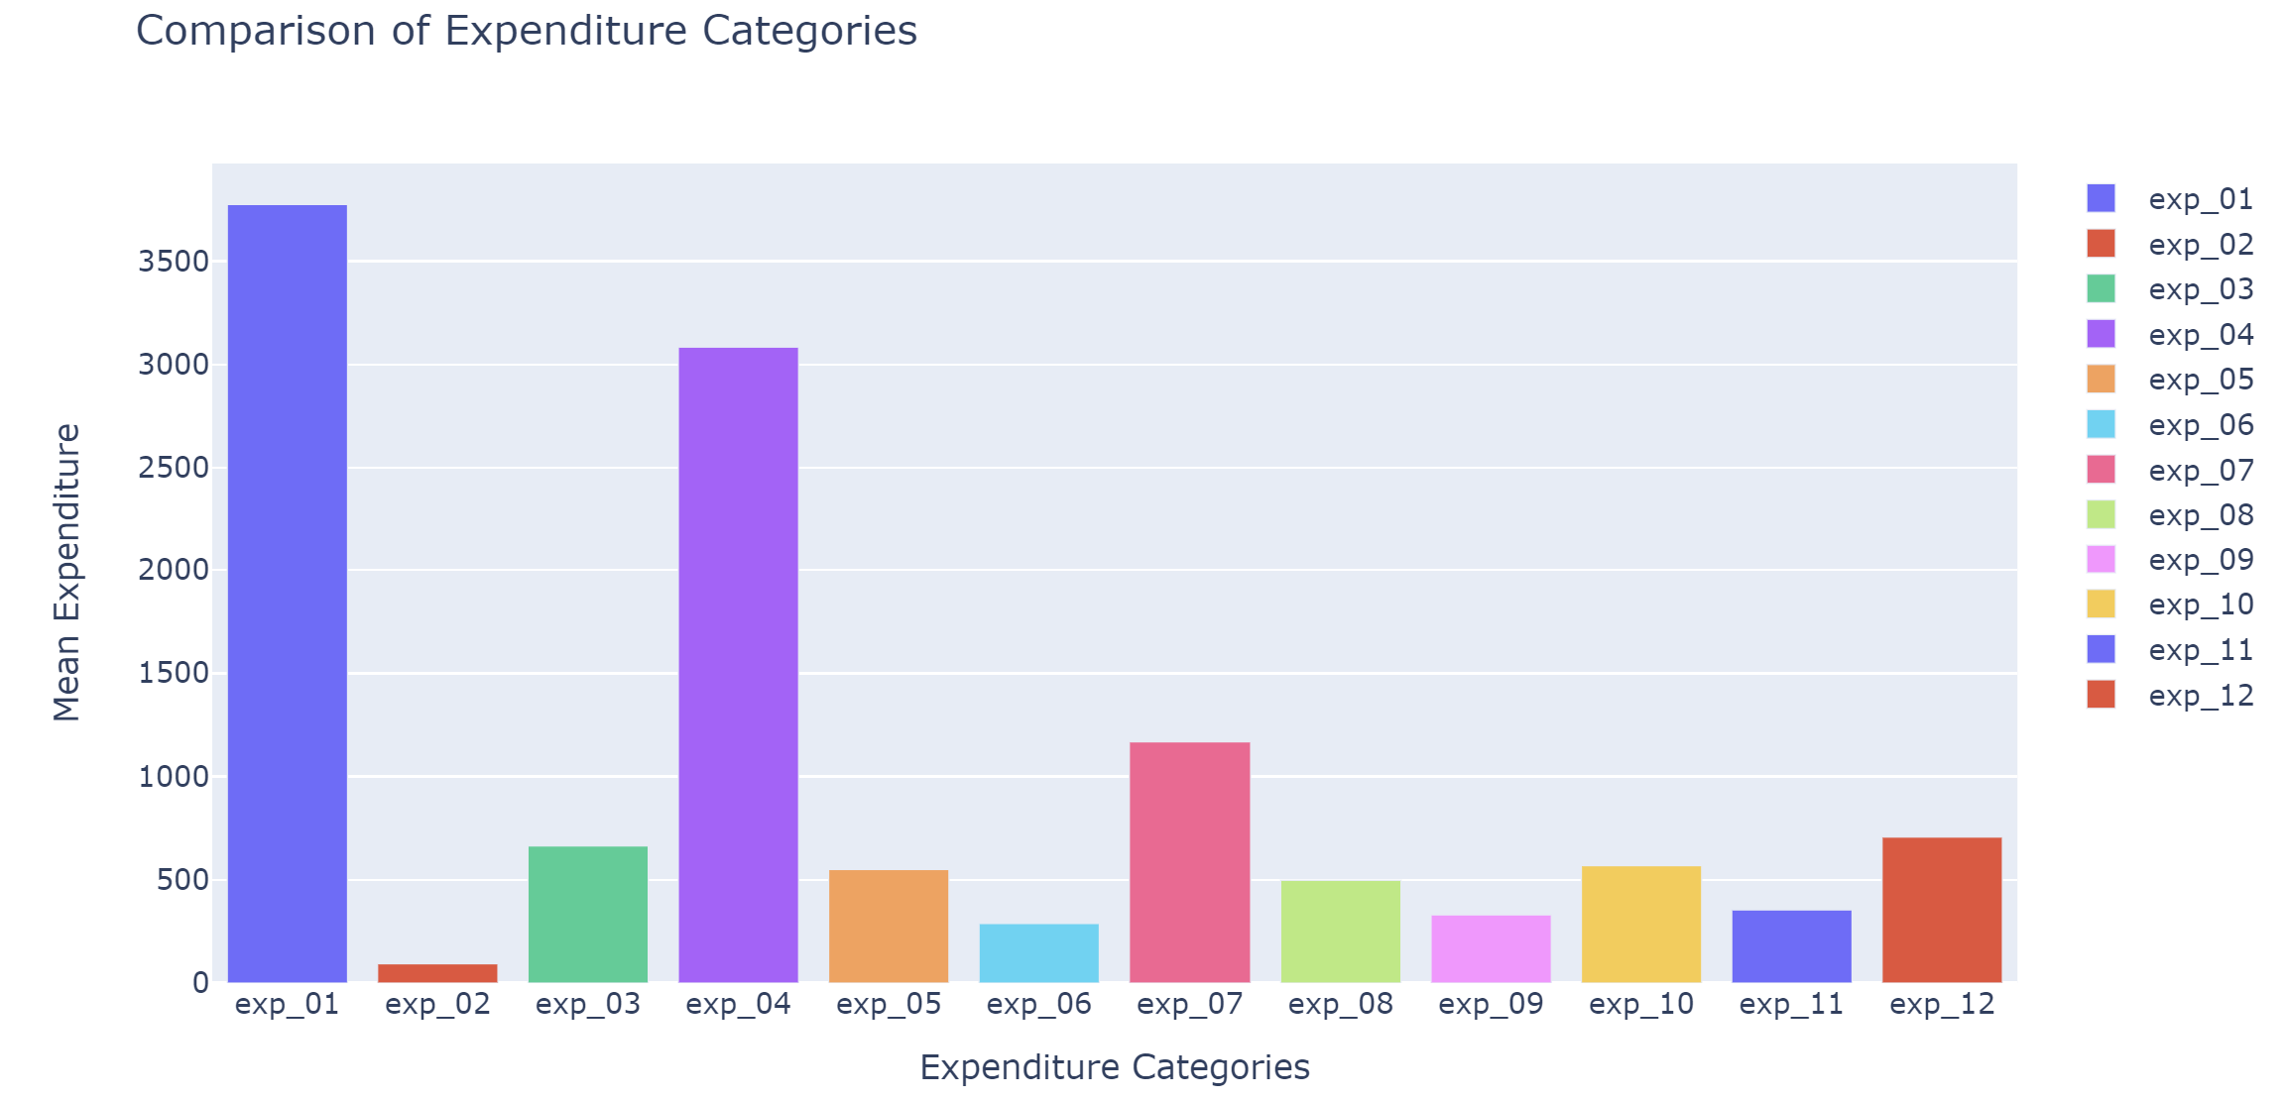
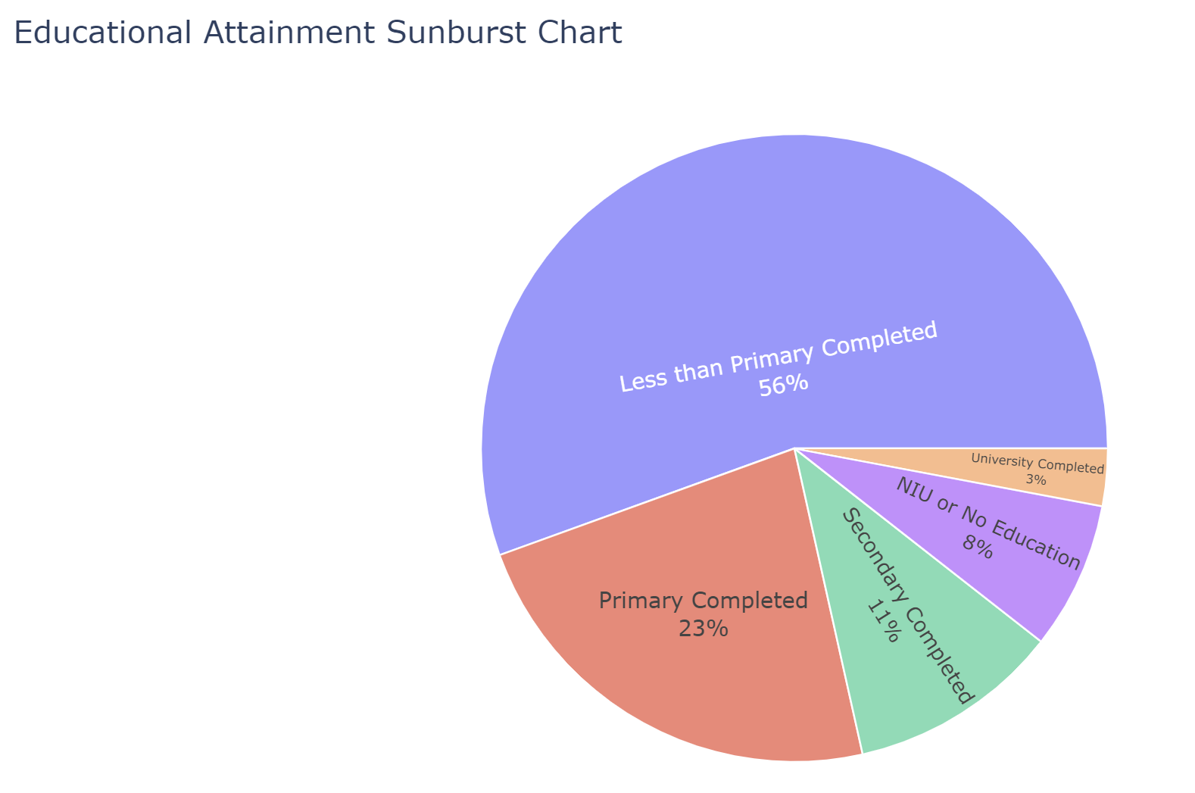
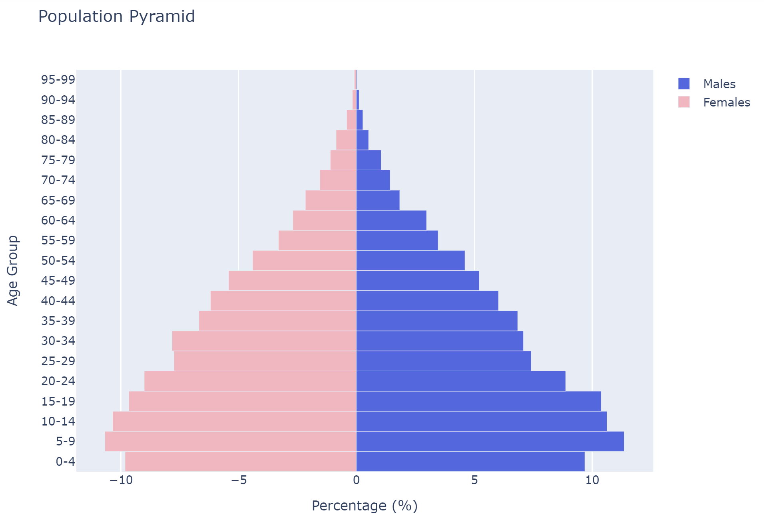

Slide 10
MISSING VALUE IMPUTATION
_ _ _ _
1.67
1.3 1.7 2
'age_month', 'ch_weight', 'ch_height', 'children_born', 'children_surv', 'births_12m’,’ deaths_12m
.mean()
_ _ _ _ _
1 1 2 1
1
‘quint_urb’,’ quint_rur’
.mode()
Some primary | 91
Some technical after primary | 92
Some secondary | 93
Some tertiary | 94
Adult literacy | 95
Special education | 96
Unknown | 98
_ _ _
92 93
‘yrs_school’
98
.cat.add_categories

Slide 11
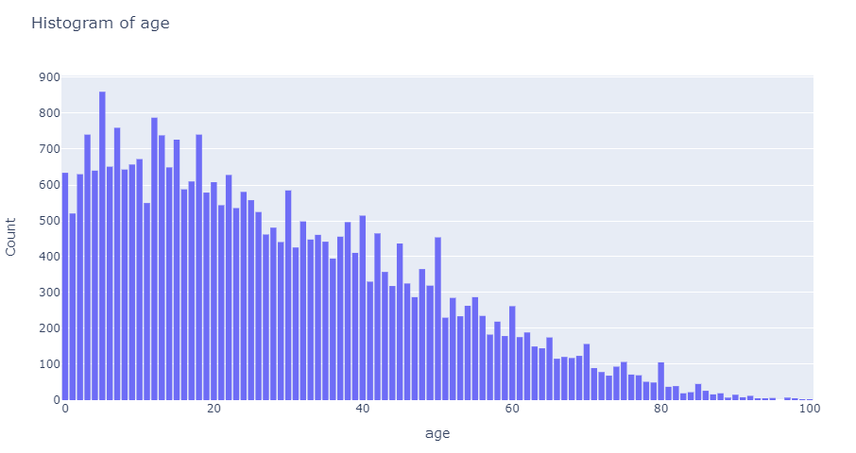
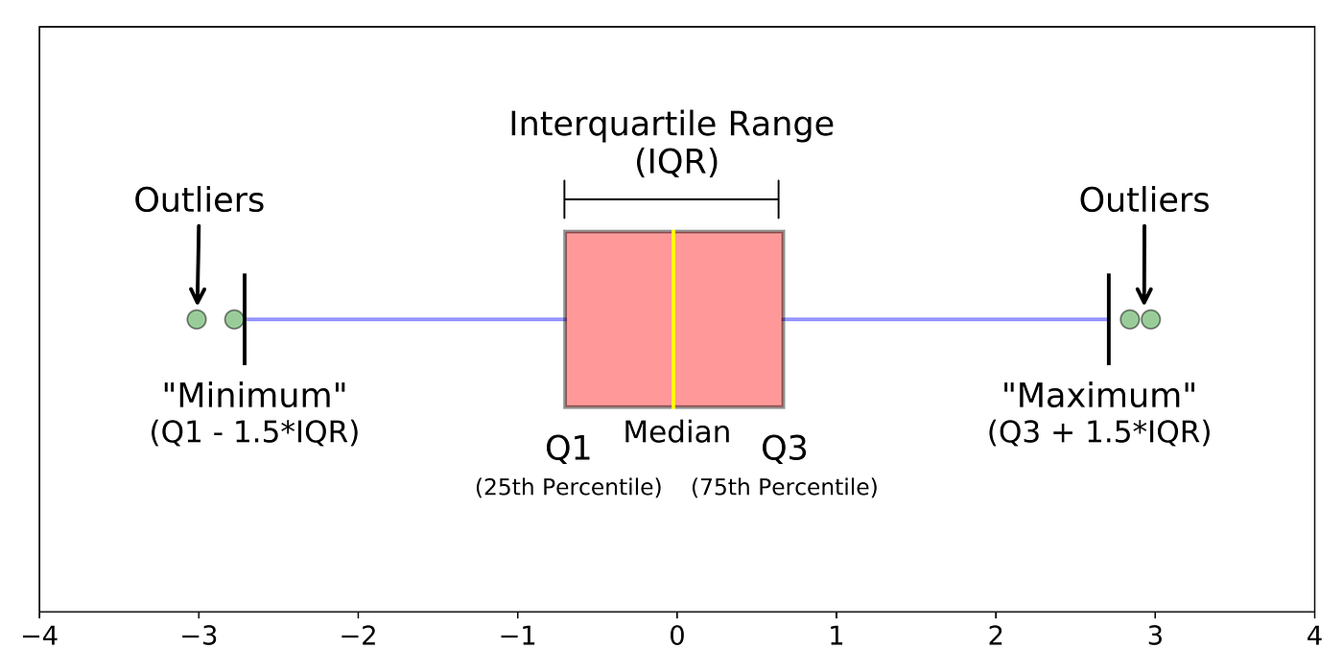
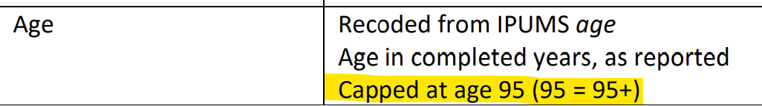
OUTLIER MANAGMENT
Plotting Histograms
IQR Method
Dataset Info

Slide 12



HOUSE QUALITY
STALE = CEMENT > TILE = METAL > LAMINATE > WOOD > THATCH >SCRAP
ROOF
WALL
CEMENT > BRICK = STONE > METAL = MUD > WOOD > CARDBOARD
FLOOR
TILE = STONE > CEMENT > WOOD > EARTH

Slide 13





HOUSE MODERNITY SCORE
DRINKING WATER
WATER SOURCE
TOILET TYPE
ELECTRICITY
COOK TYPE

Slide 14









LIFE STYLE
RADIO - 1
PHONE - 1
CELL - 2
MOTOBIKE - 3
CAR - 5
REFRIGERATOR - 3
TV - 2
BIKE - 1
BANK ACCOUNT -3

Slide 15
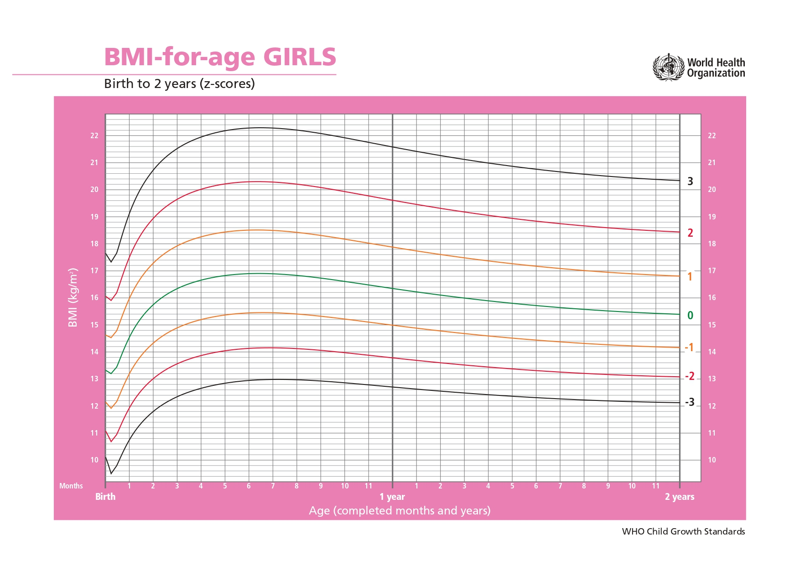
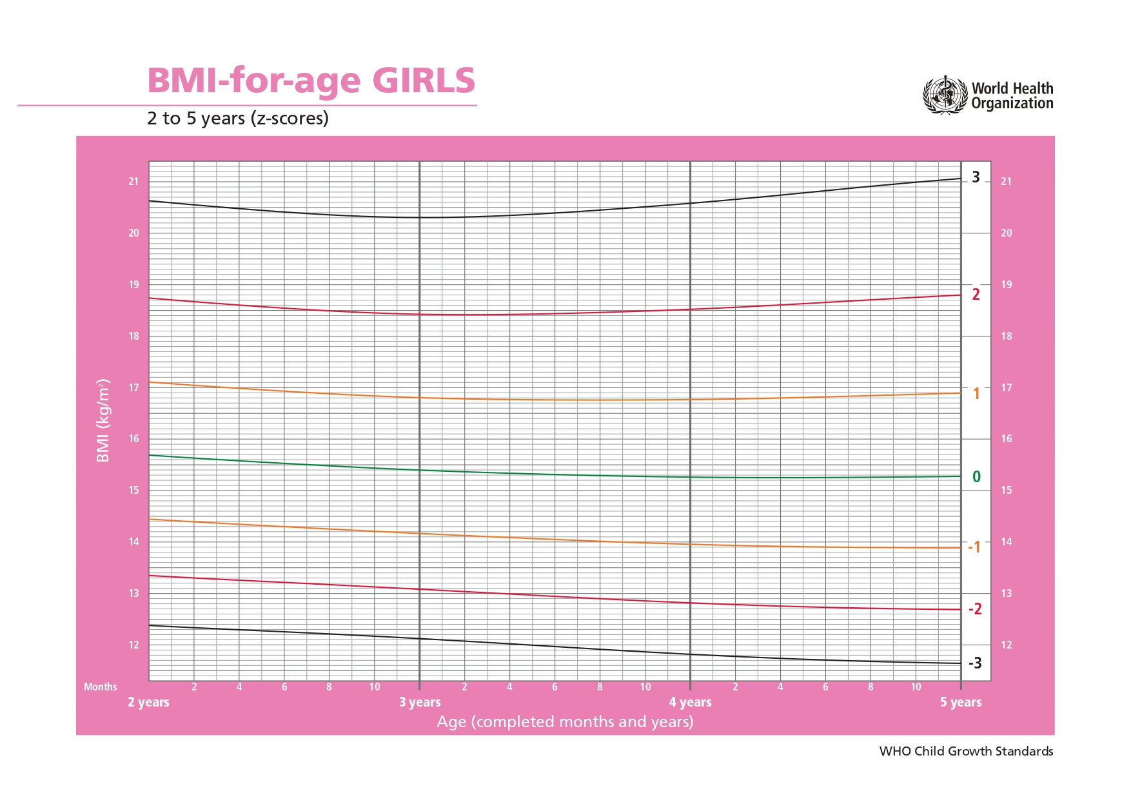
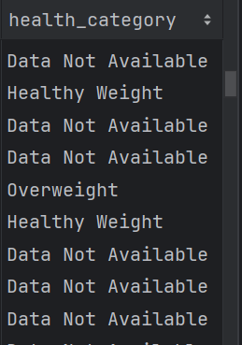
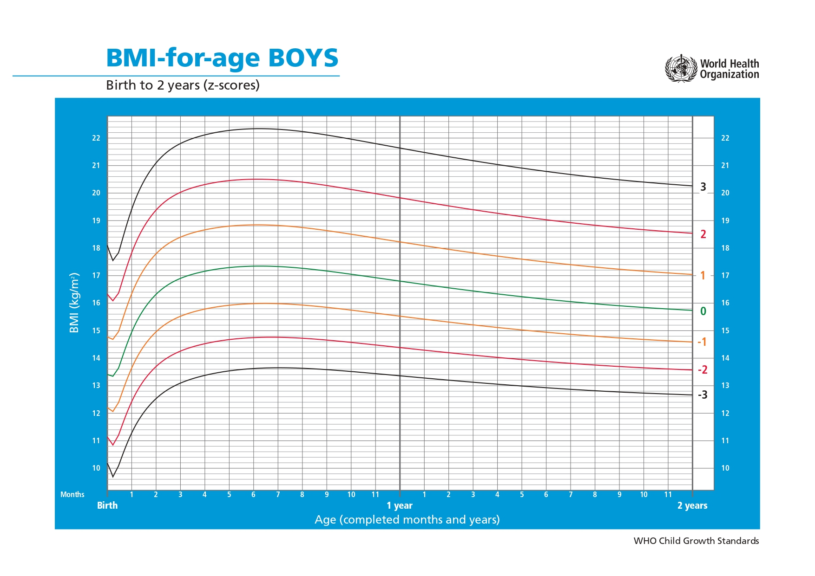
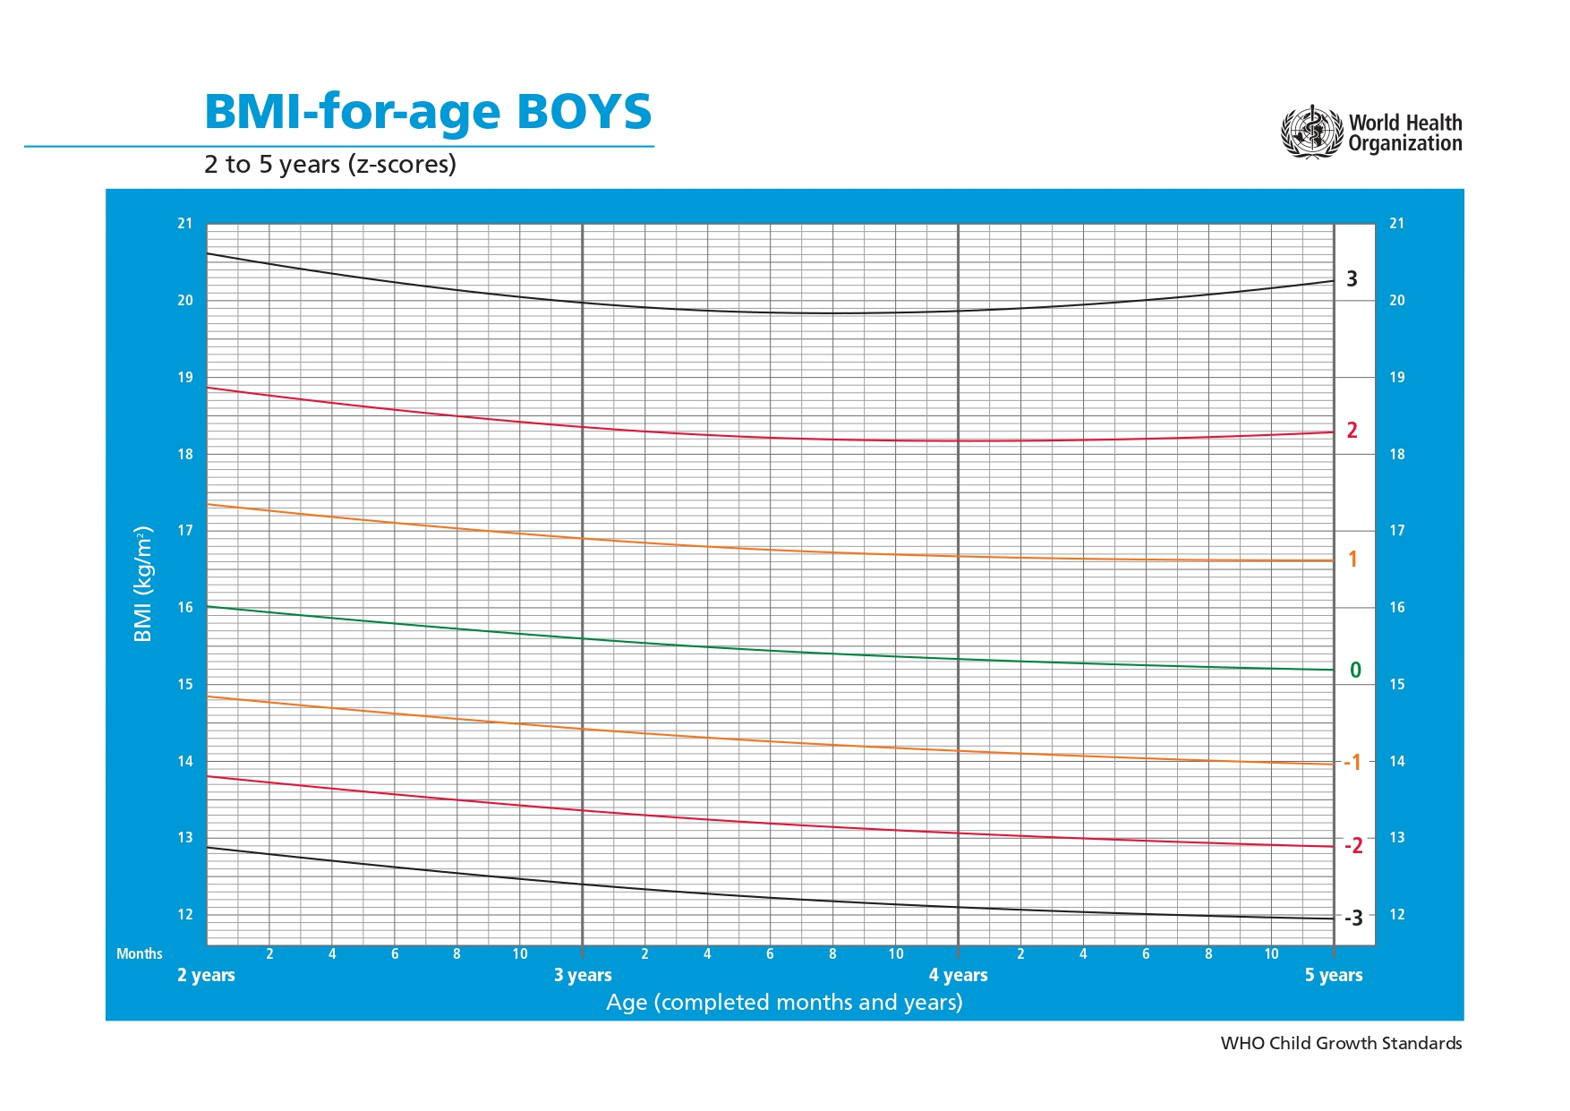
HEALTH DATA
OF CHILDREN

Slide 16
GENERATED FEATURES
num_children | womens_empowerment_index
num_elderly | disability_count
average_age | unique_religions
housing_density | health_Data Not Available_per_household
dependency_ratio | health_Healthy Weight_per_household
employment_rate | health_Obese_per_household
house_quality_score | health_Overweight_per_household
house_modernity_score | health_Underweight_per_household
lifestyle_score | health_Very Underweight_per_household
polygamous | num_male
living_conditions_level_score | num_female
highest_edu_lvl | percent_literate
avg_cmr | total_children_born
unstability_index

Slide 17
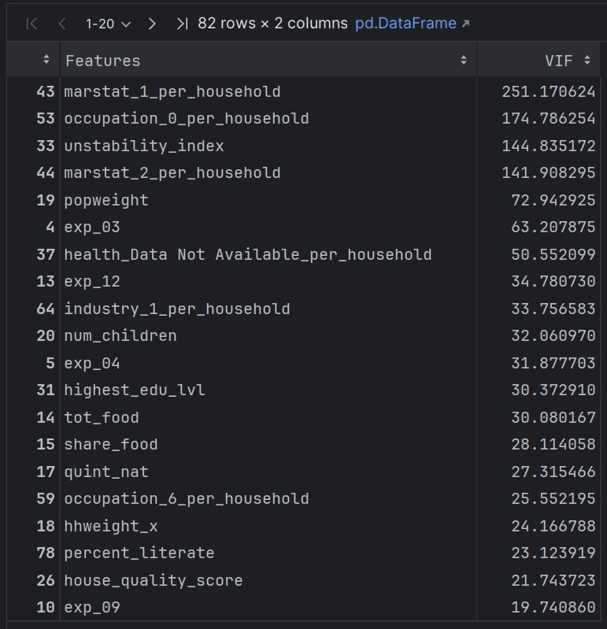
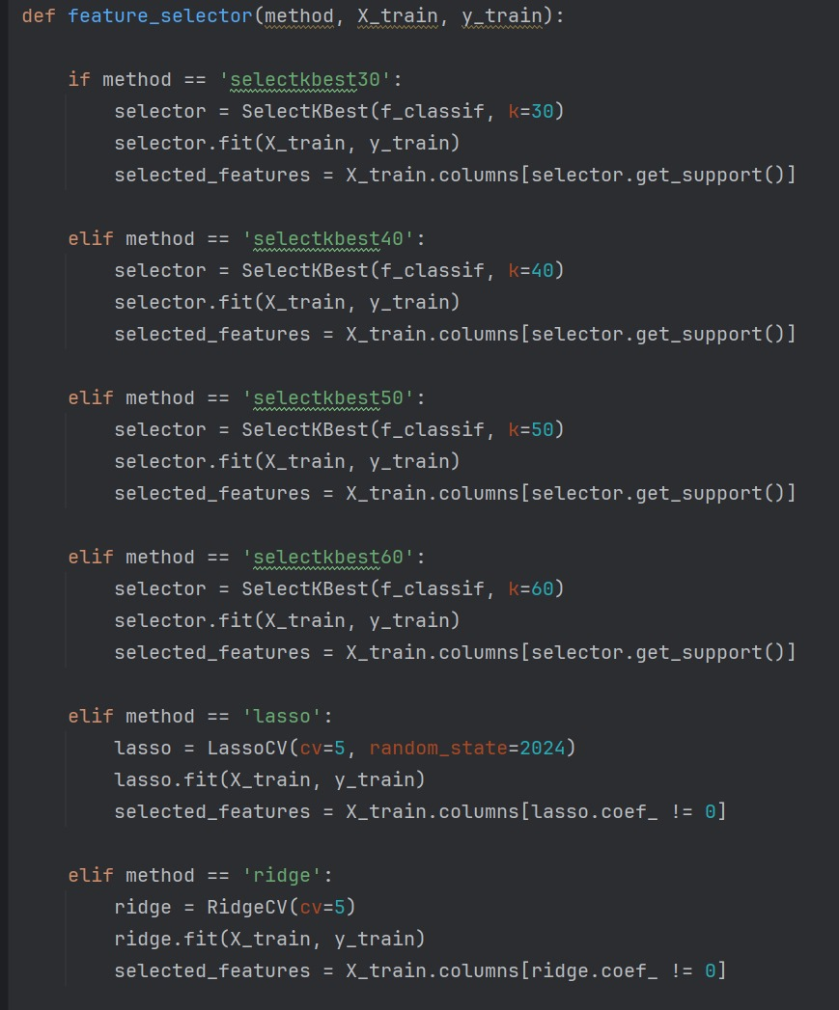
FEATURE SELECTION
Coralation Analysis
VIF Analysis
Feature selection models

Slide 18
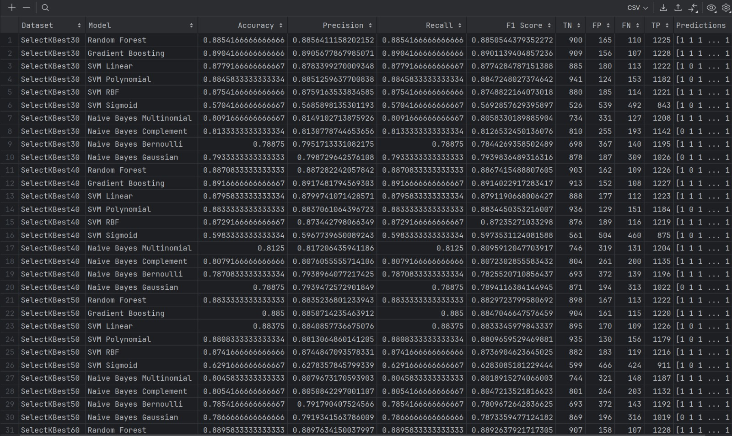
MODEL TEST RESULTS

Slide 19
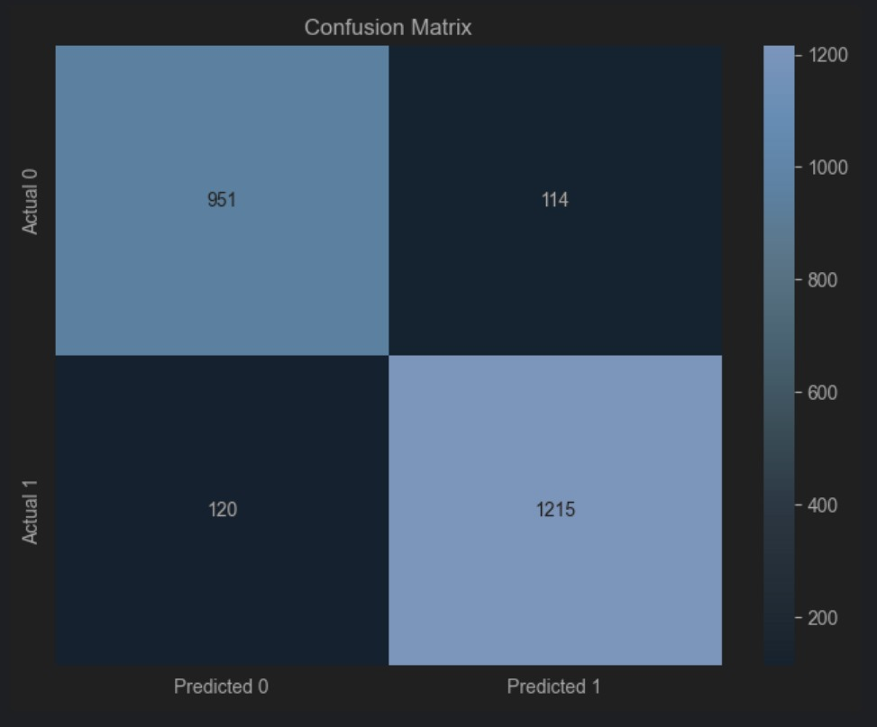
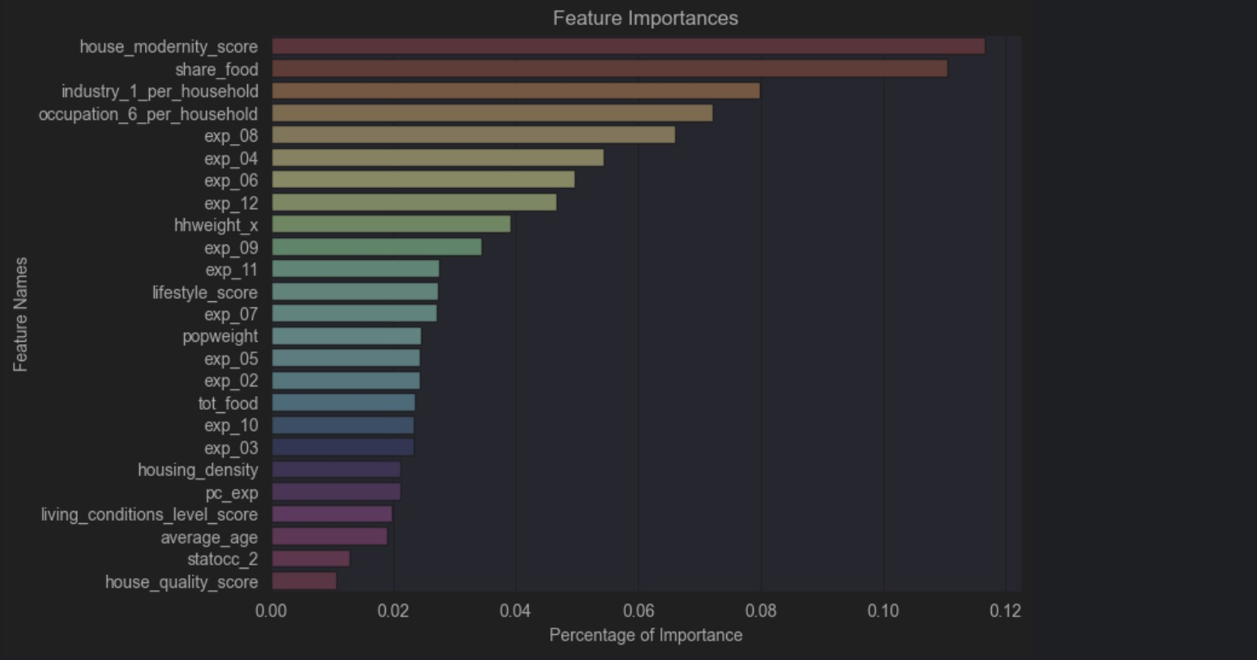
RESULT ANALYSIS
Of Best Model’s

